Slide 1
LAB 2 EXERCISE
Find Out What
Actually Happened
Five real technology ethics cases.
Dig into one, check every claim, and teach the rest of us what you found.
Communication & Emerging Technology | Group Assignment

Slide 2
The assignment
You are going to use Claude to facilitate your research and create a resource to teach the class what you found.
1
Dig in
Your group gets one real case from the past year.
2
Check it
Everything Claude hands you is a claim until you verify it.
3
Teach it
Your group shows the class what it found next week.
The focus is both on prompt-building and on your use of manual verification.

Slide 3
1
Get your group and your case
Five groups: each group will be assigned one case from the list*
Work together
Prompt alone
Submit alone
Review the case as a group. Argue about what actually matters for you to look into.
Every person writes their own prompt. Do not share one prompt.
Every person turns in their own file and prompt, whatever the group picks.
You will disagree about what matters here and how to approach it. Good! You each get to implement your own approach and compare output.

Slide 4
2
Make a folder for it
Inside your comm-lab folder, make a new one called ethics-case. Open that folder in Claude Code and work there.
ethics-case/
notes/
sources/
output/
Or just ask Claude to make them for you. That counts, and it is faster.

Slide 5
3
Write your own prompt
One prompt, written by you. Save the text, because you are turning it in.
1
THE CASE
2
SOURCES
Which case, and what happened?
Where should it look?
e.g., the Meta child safety settlement of August 2026
e.g., reputable news, court, and government sources from 2025 or later
3
CONTENT
4
OUTPUT
What must it cover?
What file do you want back?
all six items on the next slide
e.g., a .pdf slide deck I can present from

Slide 6
Six things your output must contain
Each component is part of the assessment.
THE PROBLEM
THE STAKEHOLDERS
THE TENSION
What exactly is being argued about, in plain language.
Companies, executives, regulators, courts, users, workers.
Which two good things are pulling against each other.
PRIOR CONTEXT
WHAT IS NEXT
THE QUESTIONS
Find a relevant older case as a point of comparison and discuss how that one ended.
Where do you think this is likely headed over the next few years.
Two or three discussion questions for the class.

Slide 7
Ask for receipts, not vibes
Put these three sentences in your prompt, close to word for word.
Use reputable, named sources published in 2025 or later. No blogs, no content farms, no AI-written summaries.
End with a numbered reference list. Every entry needs a title, an outlet, a date, and a working link.
Include at least three direct quotes in quotation marks, each with the speaker's name, their title, and the source it came from.
Vague prompts produce confident nonsense. Specific prompts produce something you can actually check.

Slide 8
Pick your output format
Three options – your output must be able to go up on the classroom projector.
.pptx
.pdf
HTML
Slides
Document
Webpage
Easiest to talk over. You can ask for speaker notes too!
Can also print it, mark it up, hand it around the room.
One file that opens in any browser. Nice for visuals.
Whatever you pick, name it in the prompt, and make sure the links inside it are clickable.
Ask for visuals as well: a timeline, a map of who is involved, a comparison table. Do not settle for a wall of text.

Slide 9
Verify, Argue, Push Back
Claude agrees with you by default – use that to get it to turn a critical eye on its own work.
Go back through what you just created. Find the three weakest or least supported claims and tell me why they are weak.
Which of your sources is the least reputable? Make the argument against using it.
Did you invent any quote, number, date, or link? Check each one and tell me which ones you are unsure about.
Give me the strongest argument against the side you described most sympathetically.
If it changes its answer the moment you push, that tells you how solid the first answer was.

Slide 10
Then check it yourself
Claude checking Claude is not sufficient verification. You are the ONLY ONE responsible for the final verification of anything you put your name on.
1
Click every link
It must open, and it must be the article Claude said it was.
2
Find every quote
Search the page for the exact words (e.g., Ctrl + F).
Check content AND context.
3
Match the numbers
Dollar figures, dates, and counts must match the source exactly.
4
Check the date
Make sure they match. Also, anything published before 2025 does not count as recent here (except for the older case you use as a point of comparison).
Cut anything you cannot confirm and investigate the source of the discrepancy.
Your professionalism is on the line.

Slide 11
Your name is on it
In a workplace that expects you to adapt to the use of AI tools and incorporate them into your workflows, AI error or hallucination is no excuse for errors YOU signed off on. Whatever you hand over, you are the one who said it and thus held responsible for it.
A made-up citation?
A wrong number?
An edited draft
reads as dishonesty or negligence, not a software issue. It’s an easy way to lose a room.
in a client-facing deck is your wrong number. Own your work.
is the professional standard. Verify everything yourself, cut and edit as needed.
Verify it, edit it, THEN put your name on it.

Slide 12
4
Pick one to share, but submit all
AS A GROUP
ON YOUR OWN
Choose your best
Post yours anyway
Compare all outputs from your group. Pick the single strongest one. That is what your group shares with the class next week.
Every student posts two things to the Canvas discussion board: your own output file, and the full text of the prompt you wrote yourself.
Both - even if your output is not the one the group picked.

Slide 13
How this is graded
10 pts. total:
3
Your prompt
Specific, complete, and clearly written by you.
2
Your output
Turned in on time, in one of the three approved formats.
3
The content
All six required elements are present, and they are accurate.
2
The sources
Credible, cited, links that work, quotes attributed to real people.
A broken link, or a quote you cannot find in the source, costs you points.

Slide 14
The cases
Your group gets one. A rundown of each follows, and you will get a printed copy of yours.
1
Meta and the states
Was Instagram built to hook kids on purpose?
2
Emporia, Kansas
Should a gigawatt data center be built right here?
3
AI companions
Who answers when a chatbot is a teenager's closest confidant?
4
23andMe
What happens to your DNA when the company goes bankrupt?
5
Anthropic and authors
Can you train an AI on books nobody paid for?
*
Or choose your own!
Bring me another case - get it approved before you start.
Every one of these is still moving. Check whether something changed since this deck was made.

Slide 15
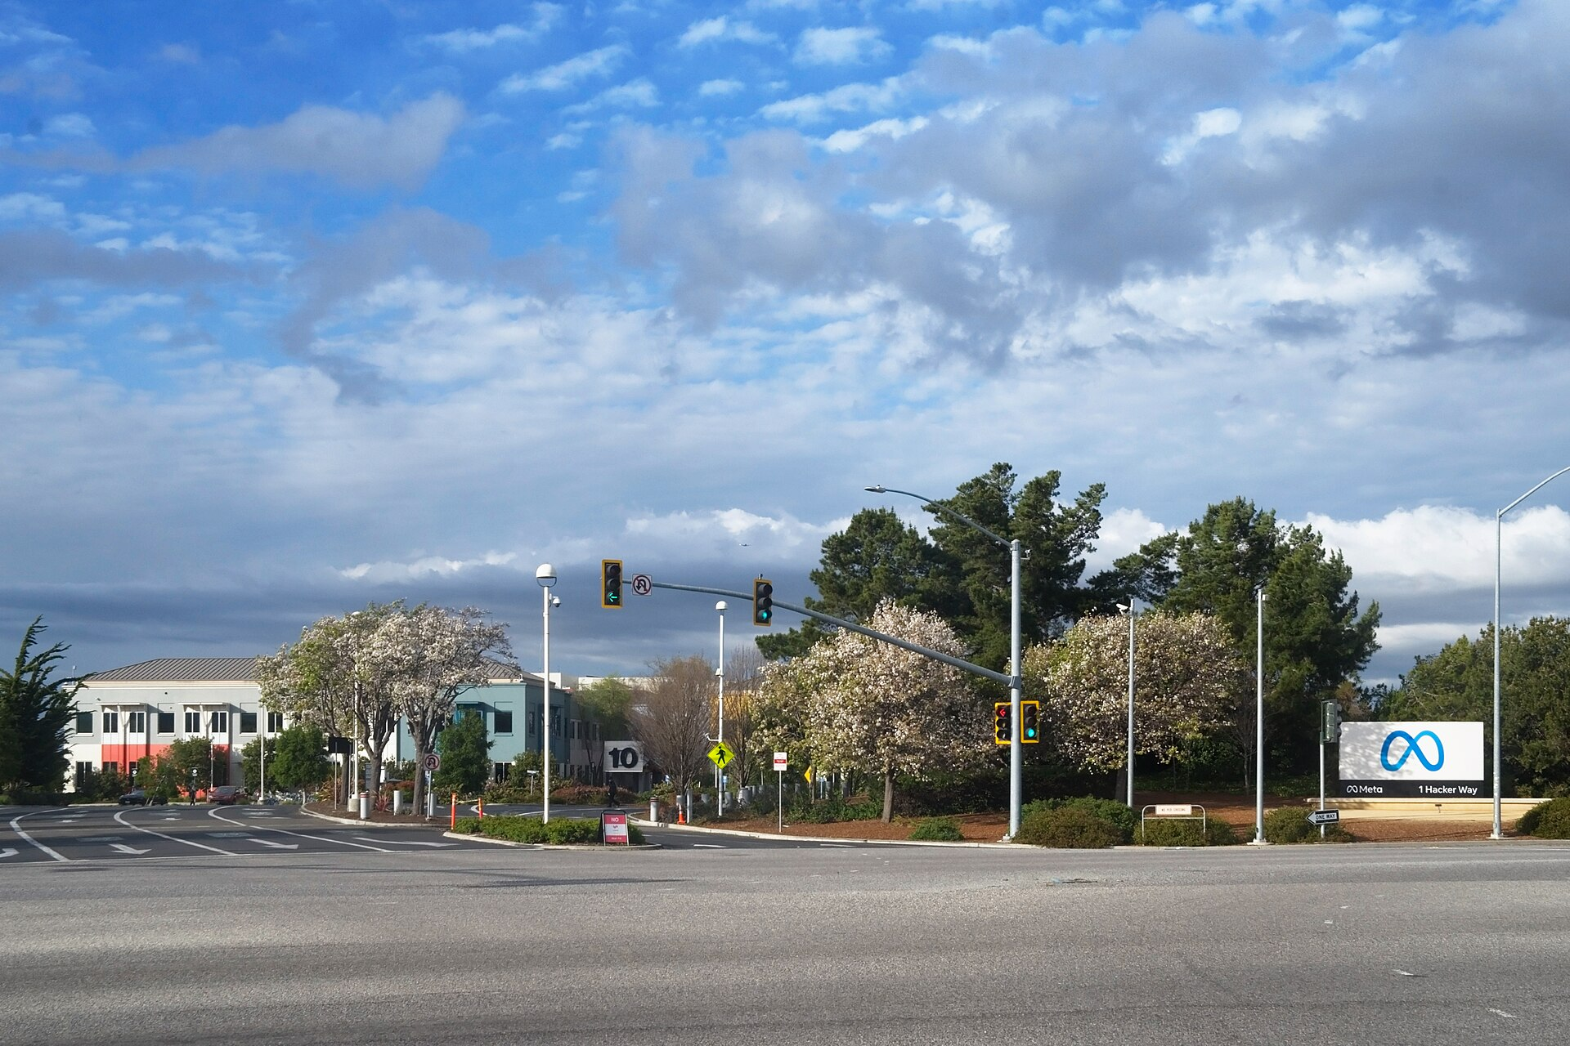
CASE ONE
Meta and the states
THE FIGHT
Attorneys general argued that Meta engineered Instagram and Facebook to keep minors scrolling, using infinite feeds, algorithmic recommendations and constant notifications, then misled the public about its own research.
KEY FACTS
Trial opened August 18, 2026 in Oakland federal court. Meta settled eight days later, admitting no wrongdoing.
Up to $17.1 billion over ten years, of which $12.1 billion is guaranteed. Meta must add teen time limits and an overnight block.
Outlets reported the total as $16.7B, $17B and $18B, and the states as 29, 51 and 52. Working out why is part of your job.
Meta headquarters, Menlo Park, California. Photo: LPS.1 / Wikimedia Commons (CC0).
START HERE
NPR, August 26, 2026 - Meta, states agree to $17 billion settlement in child safety trial
npr.org/2026/08/26/nx-s1-5944781/meta-settlement-child-safety-lawsuit

Slide 16
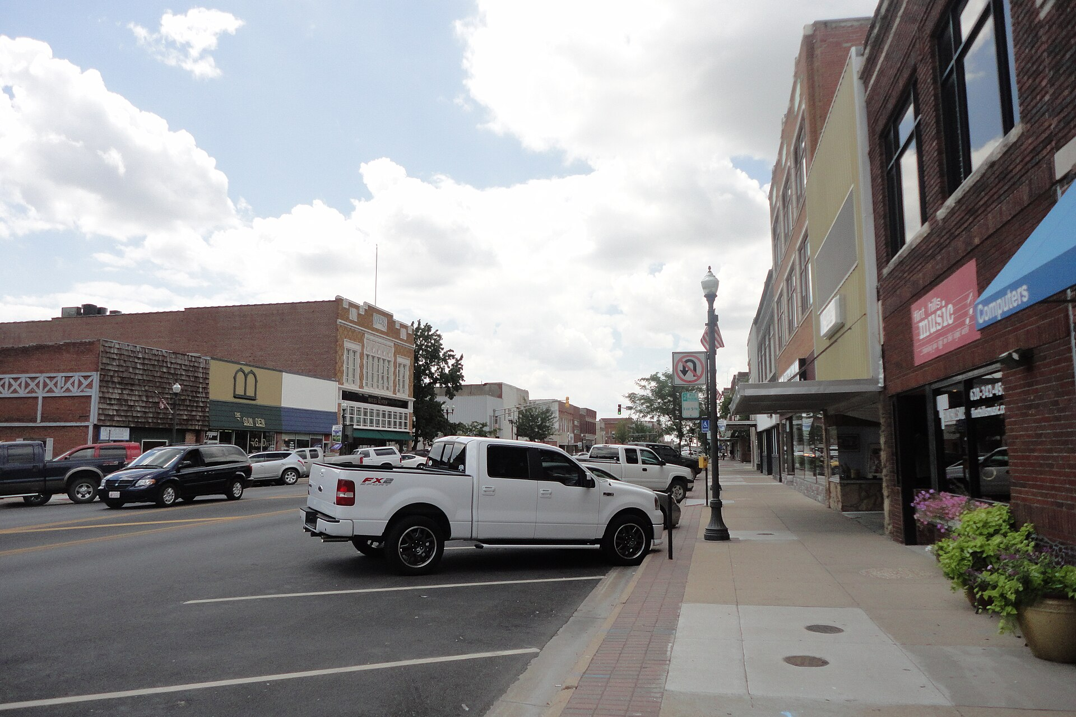
CASE TWO
Emporia, Kansas
THE FIGHT
A developer wants to build a gigawatt-scale data center on roughly 1,000 acres west of town. The city talks about jobs and investment. Neighbors ask about water, electricity, noise, and a customer that nobody will name.
KEY FACTS
Kanza Park Place announced the Flint Hills Digital Campus in June 2026. No end customer has been named.
Commissioners voted 5-0 on July 22 to create a data center zoning district. A local teacher was arrested at that meeting for clapping.
Residents filed 1,358 signatures; 804 were needed. A judge ordered the ten-year ban question onto the November 3 ballot.
Downtown Emporia, Kansas. Photo: Ethan James Scherrer / Wikimedia Commons (CC BY-SA 3.0).
START HERE
The Emporia Gazette, August 20, 2026 - Data center petition question headed to November ballot
emporiagazette.com/free/article_3647cfe5-14e3-4e67-bbd2-f34992d9d6b9.html

Slide 17
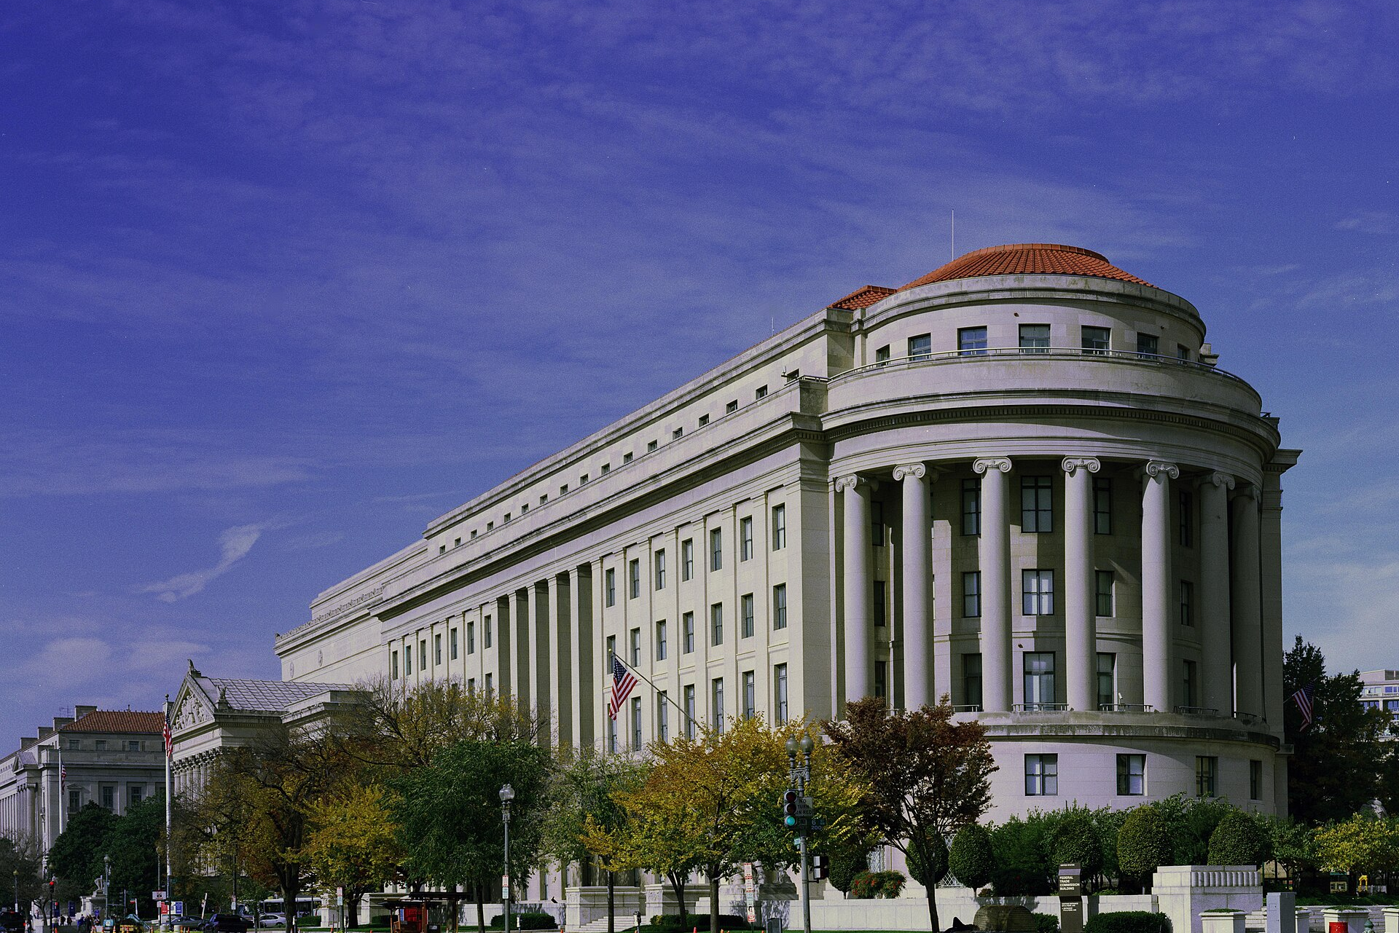
CASE THREE
AI companions and teenagers
THE FIGHT
Families sued Character.AI and Google after teenagers formed intense attachments to chatbots and later died by suicide. The question is who is answerable for a product deliberately built to feel like a friend.
KEY FACTS
The FTC opened a 6(b) inquiry on September 11, 2025 into seven companies that make AI companion products.
Character.AI barred under-18 users from open-ended chats in October 2025.
Character.AI and Google agreed in January 2026 to settle five family lawsuits. Terms were not disclosed and neither admitted liability.
Federal Trade Commission headquarters, Washington, D.C. Photo: Carol M. Highsmith / Library of Congress (public domain).
Content note: this case involves teen suicide. If you or someone you know needs support, call or text 988.
START HERE
Fortune, January 8, 2026 - Google and Character.AI settle lawsuits over teen suicides linked to AI chatbots
fortune.com/2026/01/08/google-character-ai-settle-lawsuits-teenage-child-suicides-chatbots/

Slide 18
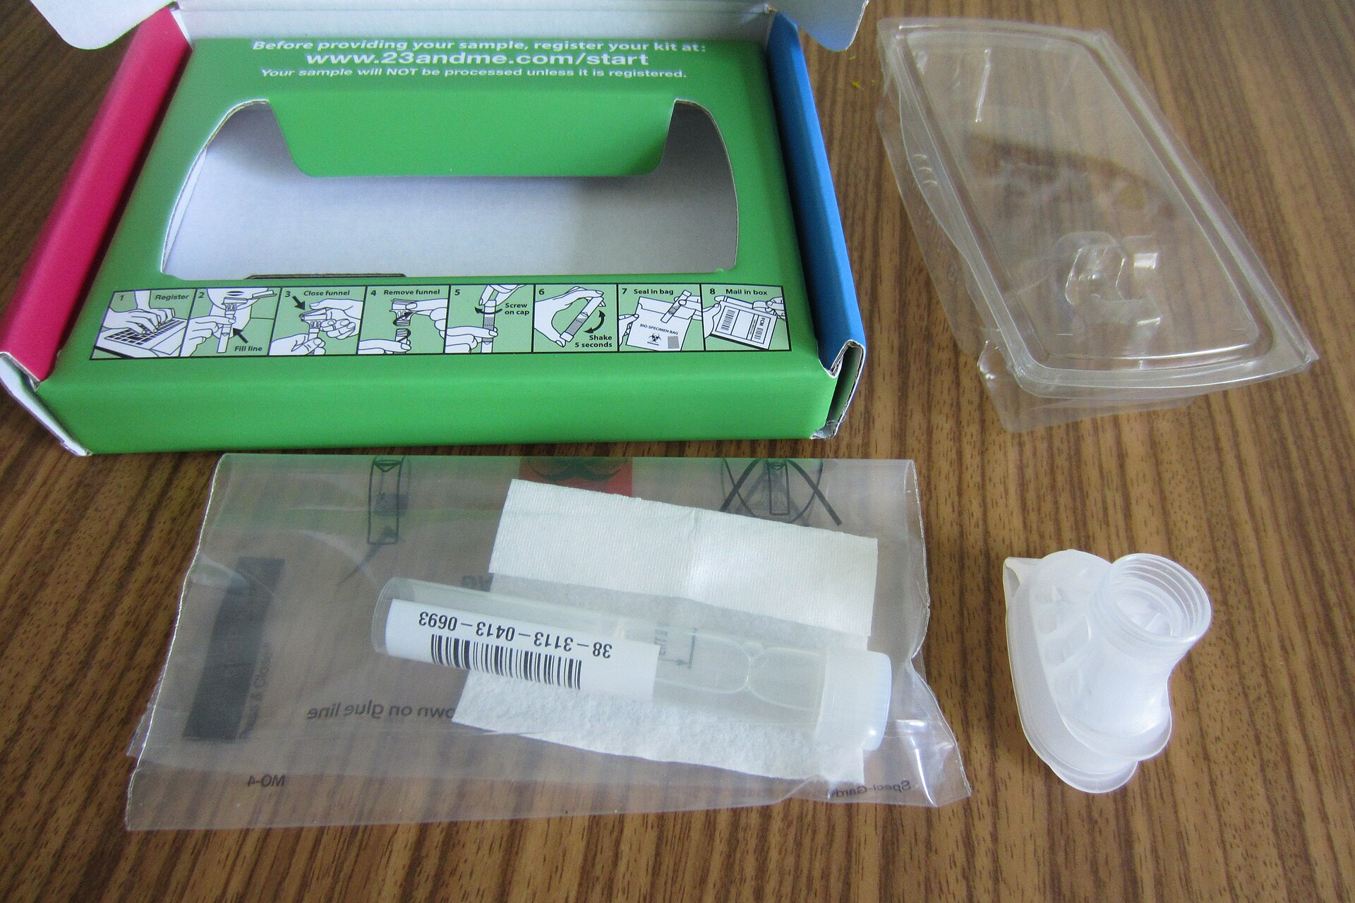
CASE FOUR
23andMe and your DNA
THE FIGHT
When a company holding the genetic data of millions goes bankrupt, that data becomes an asset to be sold. Customers who spat in a tube for ancestry results had no say in who ended up owning the results.
KEY FACTS
A 2023 breach exposed data on 6.9 million customers. Attackers built and sold lists targeting people of Ashkenazi Jewish and Chinese heritage.
23andMe filed for bankruptcy in March 2025. Its data sold for $305 million to TTAM, a nonprofit run by co-founder Anne Wojcicki.
In July 2026 more than 40 attorneys general settled. Only $18 million was actually payable. HIPAA does not cover consumer DNA kits.
A 23andMe saliva collection kit. Photo: Hanno Boeck / Wikimedia Commons (CC0).
START HERE
New York Attorney General, July 14, 2026 - AG James Secures $18 Million From 23andMe Over Genetic Data
ag.ny.gov/press-release/2026/attorney-general-james-secures-18-million-23andme-failing-protect-customers

Slide 19
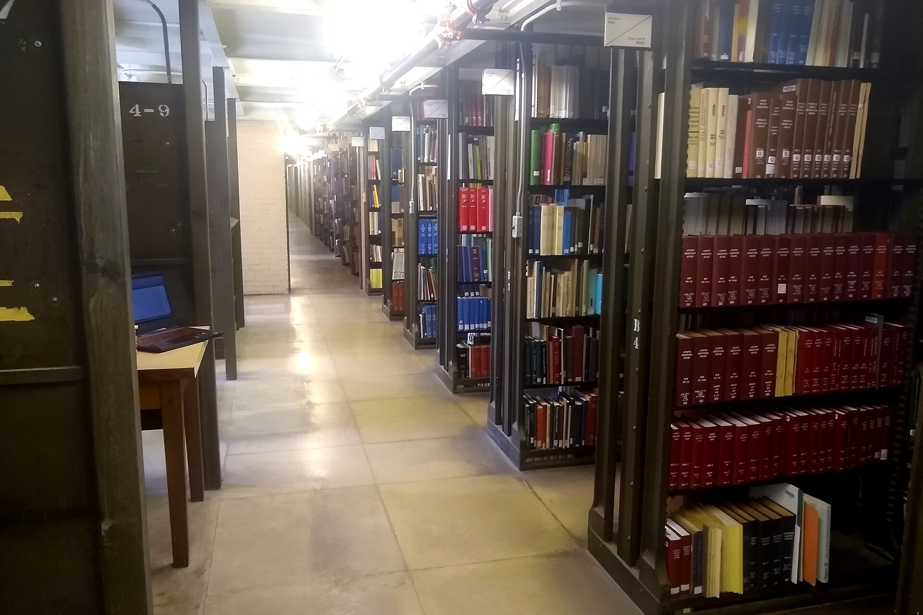
CASE FIVE
Anthropic and the authors
THE FIGHT
A judge ruled that training an AI on books can count as fair use, but that downloading those books from pirate libraries does not. Anthropic paid the largest copyright settlement in US history rather than face a damages trial.
KEY FACTS
Judge William Alsup ruled in 2025 that the training itself was fair use, but that pirated copies were not excused by it.
Anthropic settled for $1.5 billion, approved July 20, 2026. About 500,000 works at roughly $3,000 each, with no admission of liability.
Because it settled, it sets no binding precedent. Suits against OpenAI, Meta and others continue.
Library stacks, University of Illinois. Photo: Chevsapher / Wikimedia Commons (CC0).
Anthropic makes Claude, the tool you are using for this lab. Be harder on this case, not easier.
START HERE
TechCrunch, July 20, 2026 - Anthropic's landmark $1.5B copyright settlement is approved
techcrunch.com/2026/07/20/anthropics-landmark-1-5b-copyright-settlement-is-approved/

Slide 20
Choose Your Own Case
If your group would rather take on a different case, you can! If you agree amongst yourselves, just ask me first to get the go-ahead.
RECENT
REAL
COVERED
APPROVED
Something that happened in 2025 or later.
A genuine dispute with named parties, not an opinion piece.
Reported by at least two reputable outlets you can link to.
Agree amongst yourselves, then ask me to get the go-ahead.
A case close to home is fine, and often better. It still has to be documented somewhere I can read.

Slide 21
Before you leave
Three things to make sure:
1
Your file opens
You made it, you opened it, and it is in an approved format.
2
You checked by hand
Every link clicked, every quote found, every number matched.
3
Canvas has BOTH
Your output file and the full text of your prompt.
For fun: bring the thing Claude got wrong! [2 bonus pts. per discovery]

